Slide 1
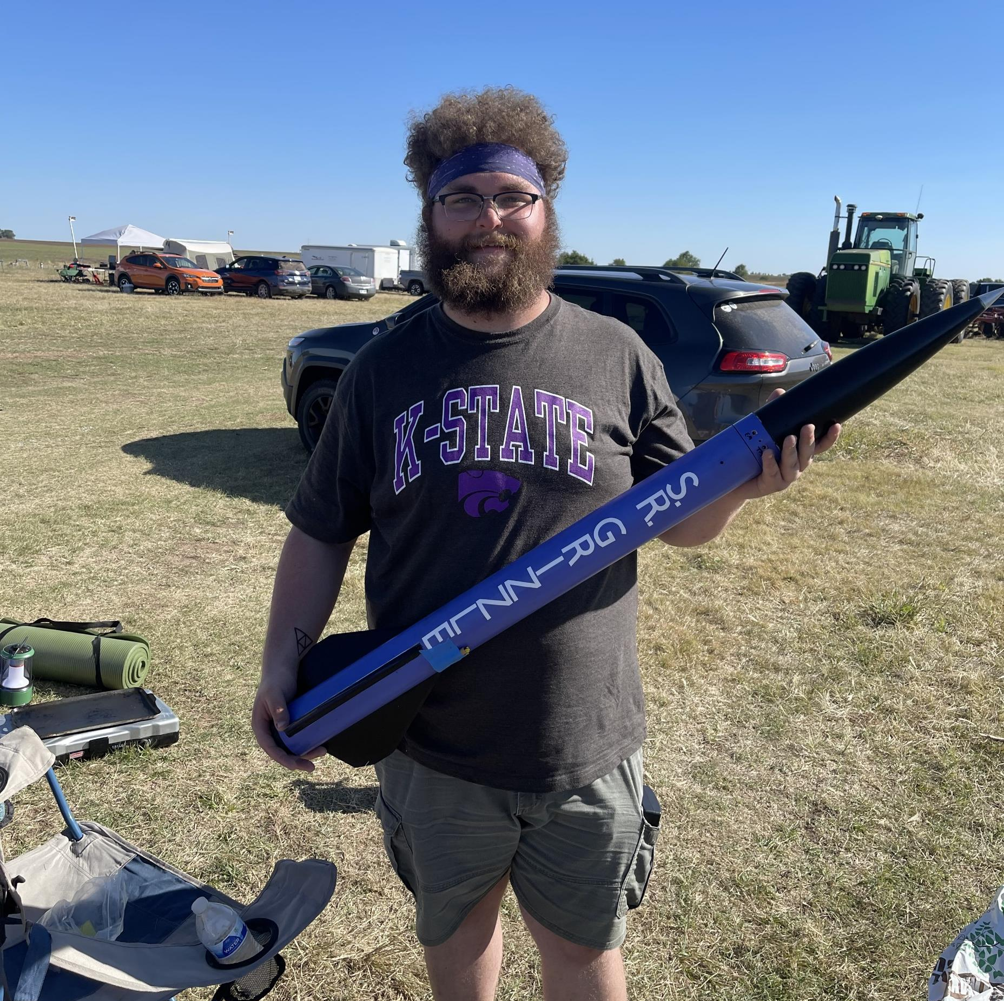
Rocket Flight Computer
Team Apogeenius
Tannyr Singleterry (L)(CMPEN)
Gannon Bird (EE)
Ethan Benne (EE)
Nathan Emerson (CMPEN)

Slide 2
Problem Statement
Wildcat Rocketry has tried doing various flight computer before to varying degrees of success. None of them either being fully functional or going past one revision.
Wildcat Rocketry this year is taking a step back from trying to design a traditional flight computer and is going towards long range tracking problem solving.
This project is to make a dedicated flight computer for Wildcat Rocketry to use or build upon later.
Notes:
Tannyr

Slide 3
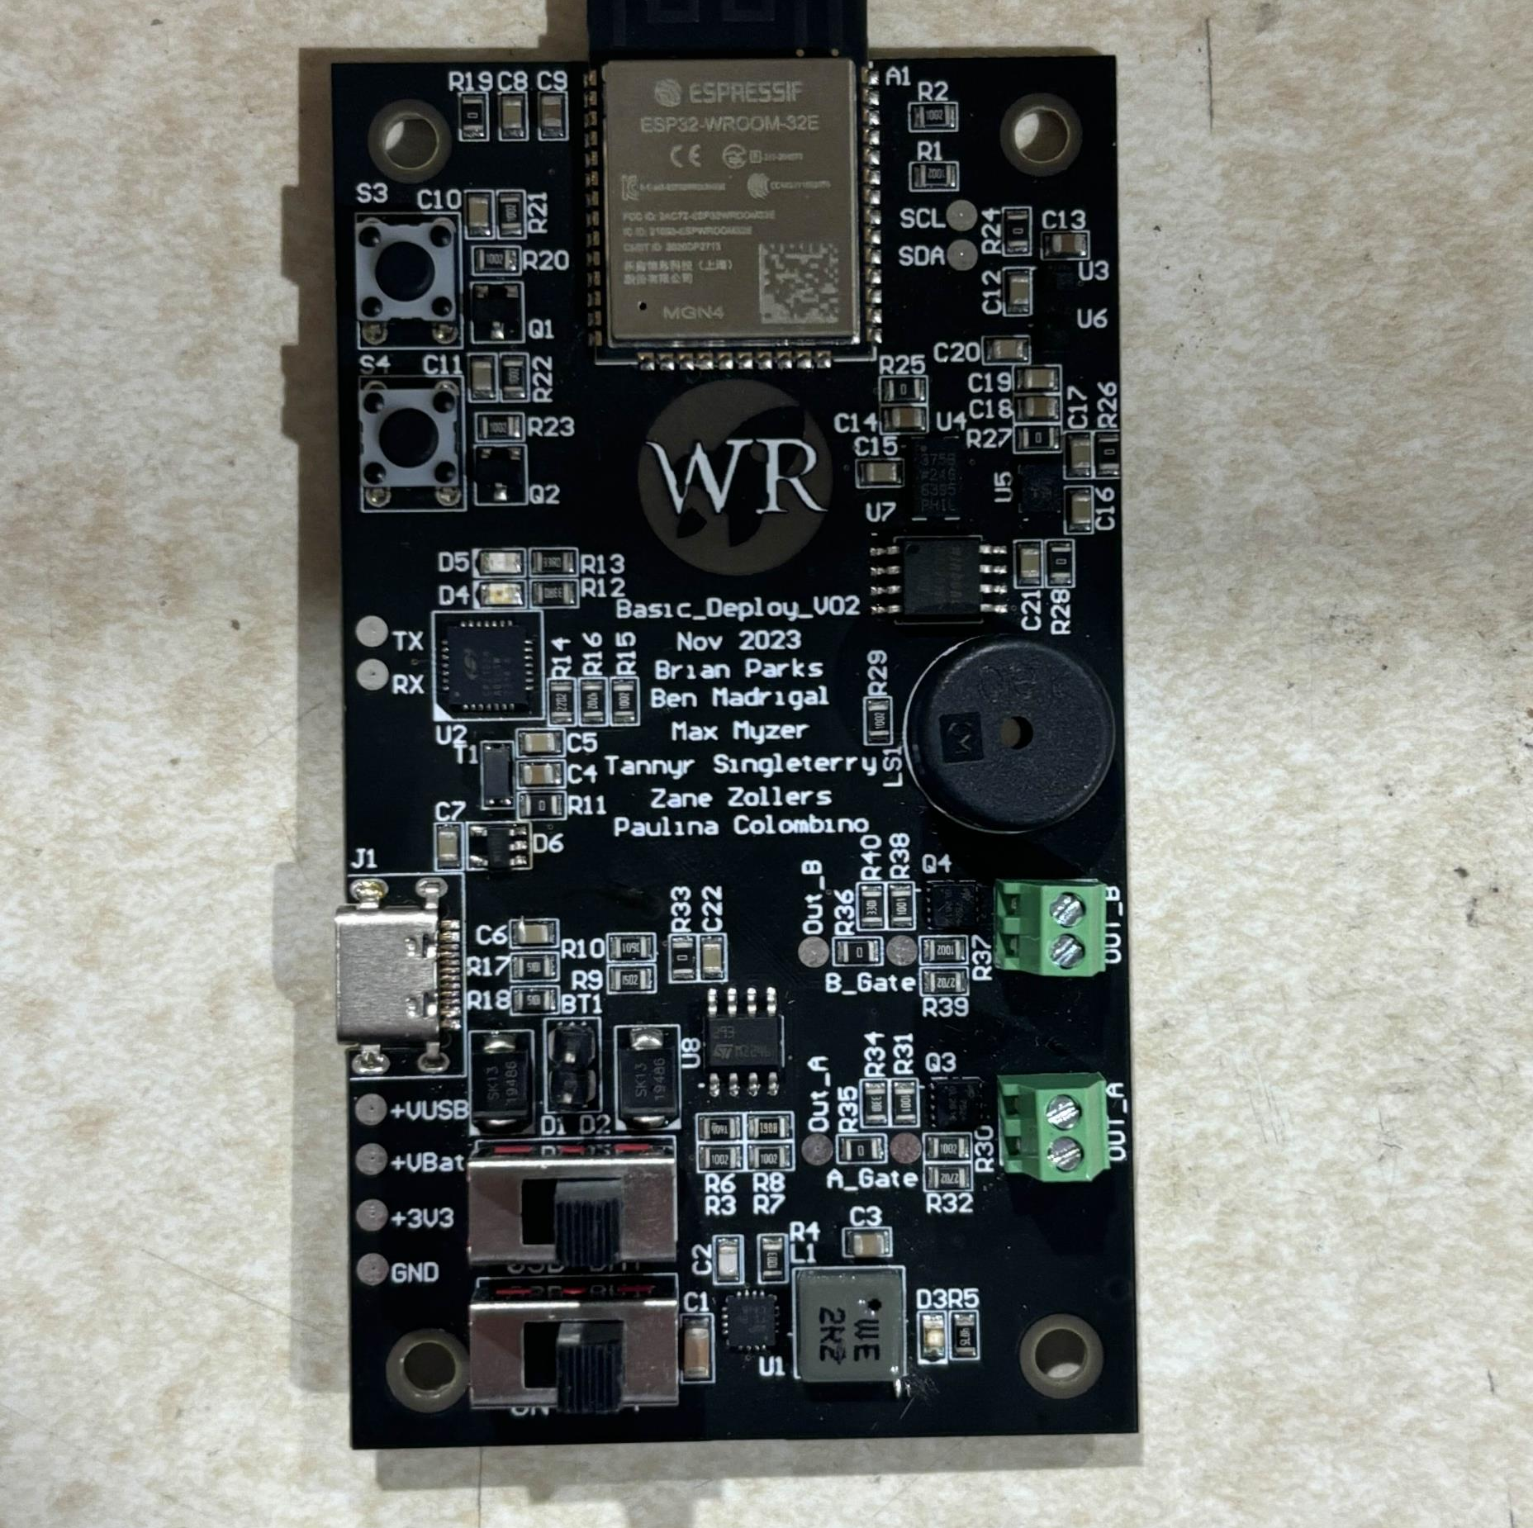
Purpose and Objective
Purpose:
Develop a flight computer to capture accurate flight data.
Objective:
Design and build a traditional flight computer that can receive data during flight and accurately display flight data.
Notes:
Tannyr

Slide 4
Customer and System Requirements
ID | Requirement | Description
1.0 | Input Voltage and Current | 2S LiPo
1.a | Minimize Power Use | Desgin Goal: The longer we can power the board the better. Minimum of 2 hours of battery life. Would like 3-4 hours
2.0 | Weight | Maximum 100 grams
3.0 | Size | Maximum 3 in width, 4 in length
4.0 | Cost | $200 or less
5.0 | Data Logging | Store at least three flights worth of data
5.a | Data Processing | Be able to process data from sensors into readable flight data
5.b | Data Export | Be able to export that data over serial or visualize over WiFi
Notes:
Tannyr

Slide 5
Verification
ID | Requirement | Analysis | Demonstration | Inspection | Test
1.0 | Input Voltage and Current |  |  |  | X
1.a | Minimize Power Usage |  |  |  | X
2.0 | Weight |  |  | X
3.0 | Size |  |  | X
4.0 | Cost | X
5.0 | Data Logging |  |  |  | X
5.a | Data Processing |  |  |  | X
5.b | Data Export |  | X
Notes:
Tannyr

Slide 6
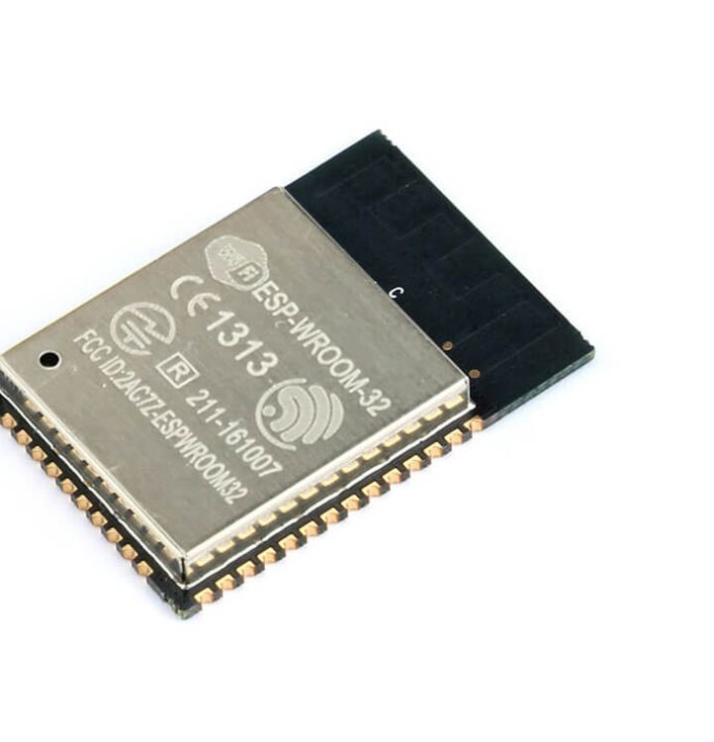
Design Concept 1: Microcontroller
Description:
Microcontrollers are powerful small computers used on a single integrated circuit. There is a wide variety of microcontrollers, differing with regards to processing power, I/O capabilities, and data storage.
Pros:
Easy to use
Controlled power consumption
Cons:
Serial execution
Internal peripherals can limit scope.
Image Source
Notes:
Nathan

Slide 7
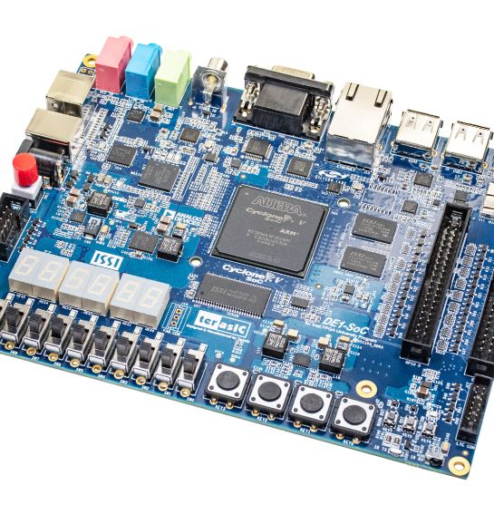
Design Concept 2: FPGA
Description:
FPGAs are a configurable integrated circuit that can be repeatedly programmed after manufacturing. FPGAs contain logic blocks and allow a programmer to connect these blocks and configure them.
Pros:
Can be programmed at logic level (parallel processing).
Can be reprogrammed.
Cons:
More complex coding
No control of power consumption.
Image Source
Notes:
Nathan

Slide 8
Design Criteria Table
Need | Engineering Requirement | Weight (1-10) | Base line | Concept 1 | Concept 2
Lightweight | Weight < 100 grams | 3 | 5 | 5 | 5
Lower Power Consumption | Minimum 2 hours battery life | 5 | 5 | 7 | 3
Data storage | Can store multiple flights worth of data | 7 | 5 | 7 | 5
Ease of use | Easy to use interface | 7 | 5 | 9 | 3
Affordability | Unit production cost < $200 | 3 | 5 | 7 | 3
Connectivity | Be able to output data via serial | 5 | 5 | 5 | 5
Reliability | Produces data consistantly | 10 | 5 | 4 | 6
Compact | 3 inches width, 4 inches length | 10 | 5 | 7 | 5
Accuracy | Produces accurate data | 7 | 5 | 4 | 7
Total |  |  | 285 | 346 | 279
Notes:
Nathan
Compact – FPGA requires more peripherals

Slide 9
Final Score and Selected Design
Final Scores:
Microcontroller: 346
FPGA: 279
We have decided to go with a microcontroller as the main chip in our flight computer.
But which microcontroller?
Notes:
Nathan

Slide 10
Microcontroller Options
ESP32-C6:
Pros: User friendly, wireless connectivity, imbedded flash module built in
Cons: Higher Power Consumption, takes up more board space.
STM32F042F6:
Pros: Lower Power Consumption, Takes up small board space
Cons: Slower Clock Rate, low number of GPIO
ATMMEGA328P:
Pros: Takes up small board space, lower power consumption, same chip used in Arduino uno.
Cons: 8-bit Processor, Low number of GPIO
Notes:
Gannon

Slide 11
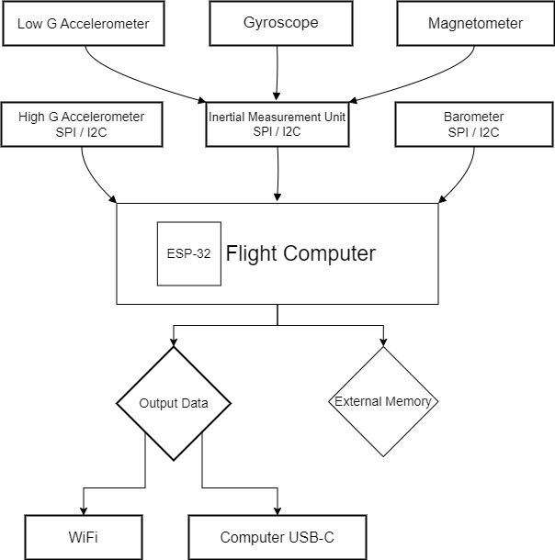
Block Diagram & Interfaces
Notes:
Gannon
USB – Used for taking data from flight computer.
Microcontroller – ESP32 built in transceiver to get data via WiFi.
Sensors – Uses SPI and I2C to communicate with board.

Slide 12
Cost/Budget
Plan for two board revisions
First one cheaper with buttons for debugging.
Second revision to improve design and fly.
First board Revision
PCB - $4.00
Sensors - $20.00
Microcontroller - $10.00
IMU - $30.00
Total for first revision: $64.00
Notes:
Ethan

Slide 13
Feasibility Assessment/Risks
Feasibility
This project is feasible in our eyes. We must make sure to communicate well and stay on top of everything.
We have a good group that covers each other weaknesses. We have a balance between EE and CMPEN.
Risks
Batteries
Overheating and damage to batteries can be a fire hazards.
Over budget
Underestimating price of various components and going over asking budget.
Vibration/Bad Flight
If the rocket has a bad flight, it can rattle the electronics with vibrations.
Notes:
Ethan

Slide 14

Conclusion
Our Choice:
Design 1: Microcontroller (ESP-32)
User friendly
Reliable
Familiar to our group
Notes:
Ethan

Slide 15
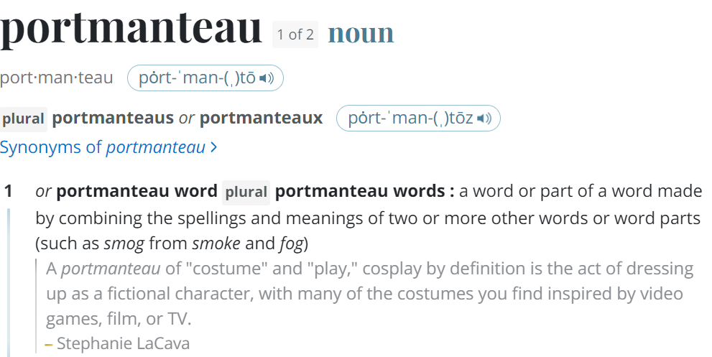
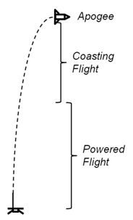
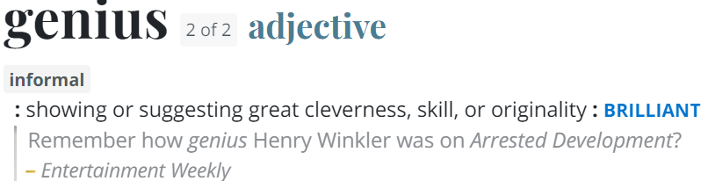
Questions
Image Credit: https://ffden-2.phys.uaf.edu/webproj/211_fall_2014/Adam_Kurzbard/Adam_Kurzbard/Page4.html

